Slide 1
Two Tricks and a Time Machine
Marcel Gietzmann-Sanders
September 20, 2024

Slide 2
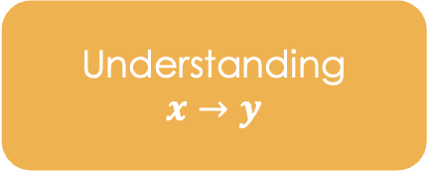
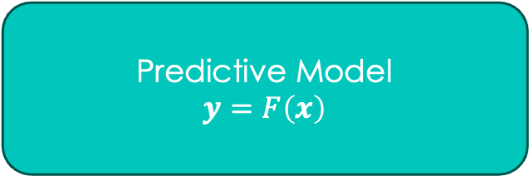
Setup
Predictive Model
$$y=F\left(x\right)$$
Expectations in a Scenario
Understanding
$$x→y$$
Practical Insights

Slide 3
Goal
Machine Learning:
Automated Pattern Finding
Goal:
To build tools that make log-odds modeling as quick and easy as possible
Log-Odds:
Dimensionality Reduction
The Cloud:
Buying Time with Money

Slide 4
Solution
Mimic:
Demo!
Application for Building Log Odds Models in the Cloud
Working with Haven
Working Watercycle
Building a Model
Running a Model
Haven:
CLI for Setting Up and Interacting with in Cloud DB
WaterCycle
Infrastructure as Code

Slide 5
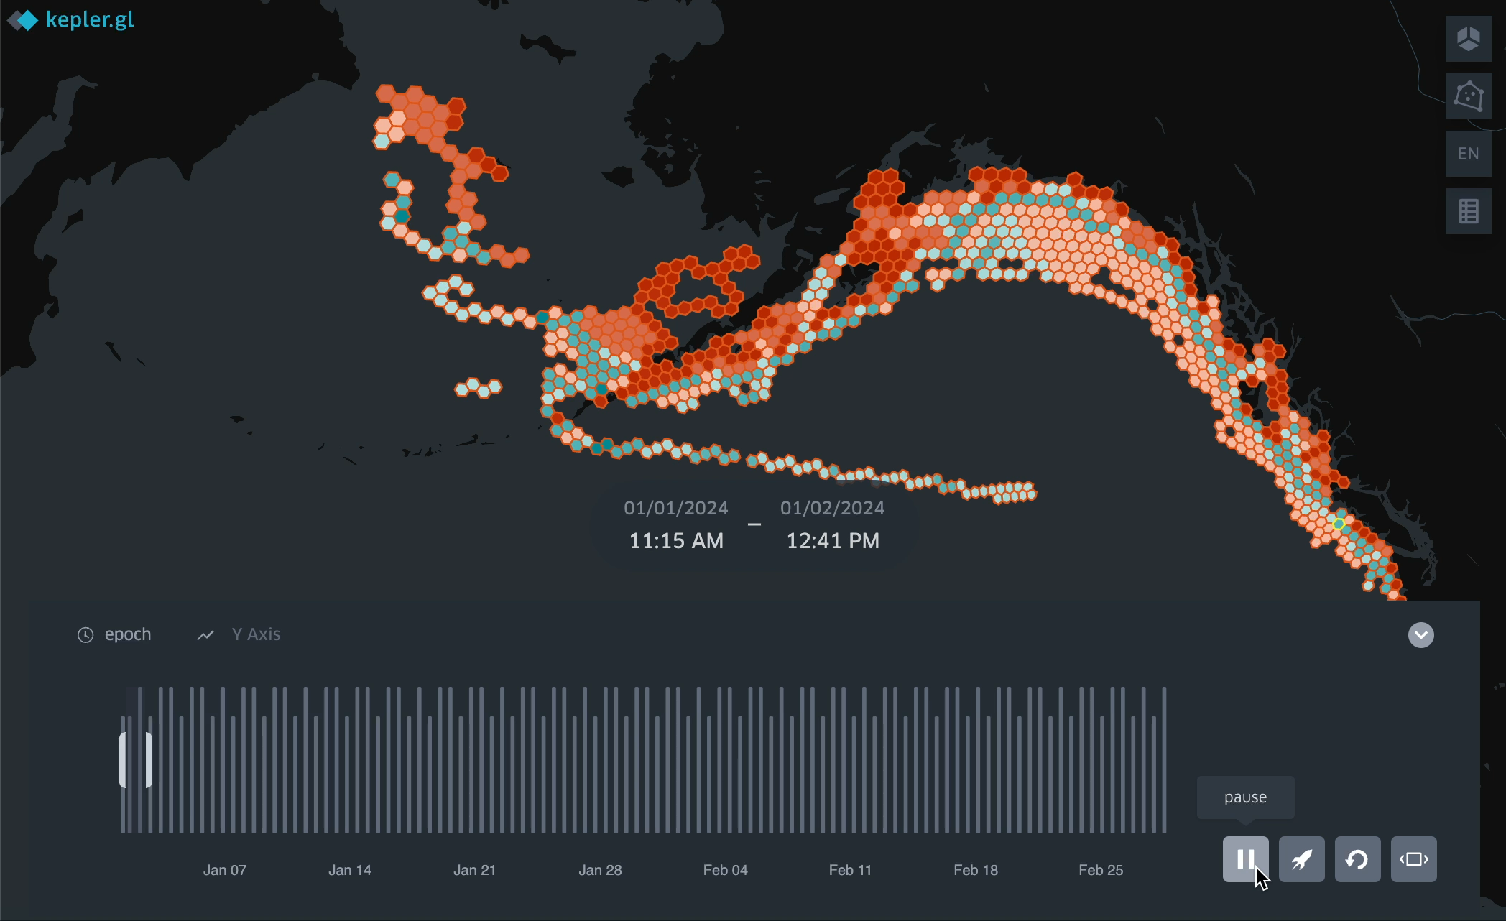
Results
Depth Class 25, January

Slide 6
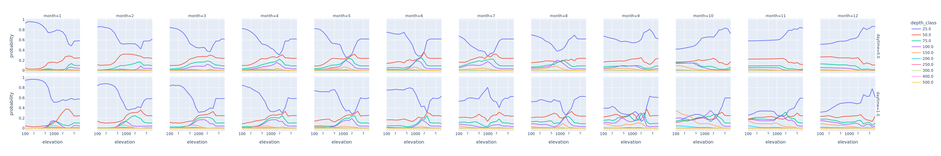
Results

Slide 7
Conclusions
Now have the machinery to build log-odds models with ease
Very quick and very cheap
Can focus on generating insights (the human bit!)

Slide 8
Next Steps
Build Movement Model(s)
Explore Tools for Less DIY Simulation/Hypercube Exploration
Work on Data Ingest

